Slide 1
Music Recommendation System
Mrinal Bhardwaj
Ashutosh Kumar Bharti
Ankitha R Desai
Muskan A
Rutvik S Jaiswal

Slide 2
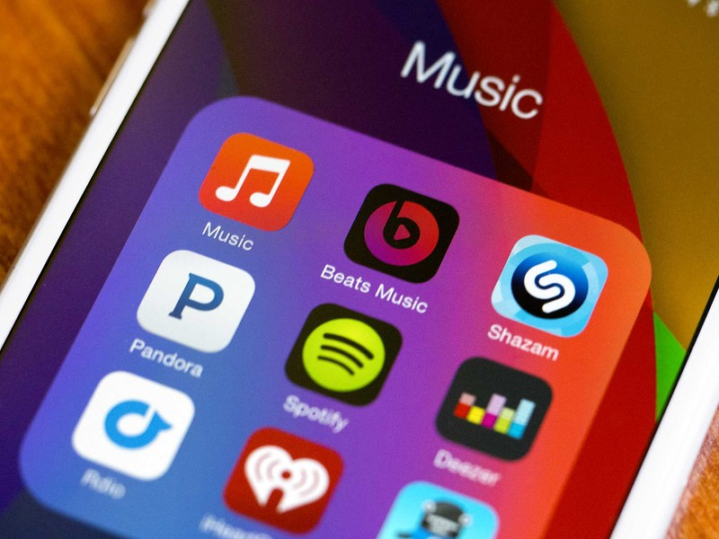
What is Music Recommendation System?
In comparison to past eras, commercial music streaming services that can be accessed via mobile devices have increased the availability of digital music.
Sorting through all of this digital music takes a long time and generates information overload.
As a result, developing a music recommender system that can automatically search through music archives and recommend appropriate songs to consumers is quite beneficial.

Slide 3
Goal of this project.
The goal of the project is to design and develop a “Music Recommendation System” that will detect preferences and produce a playlist based on them. We are using the spotify dataset provided by Kaggle and building this recommendation system using Content based recommendation and Nearest Neighbor.

Slide 4
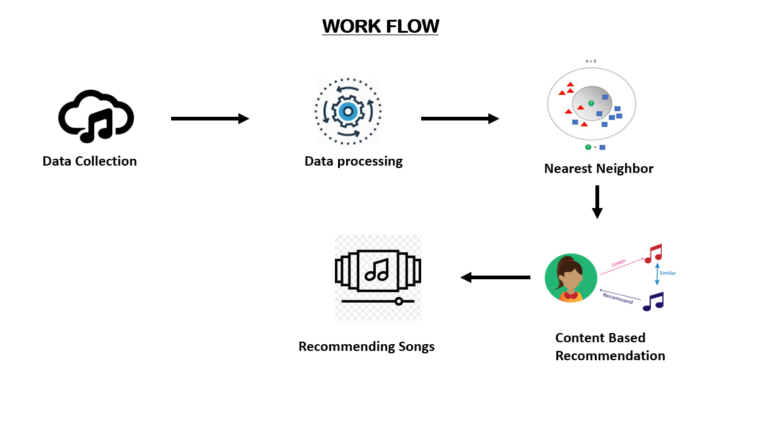

Slide 5
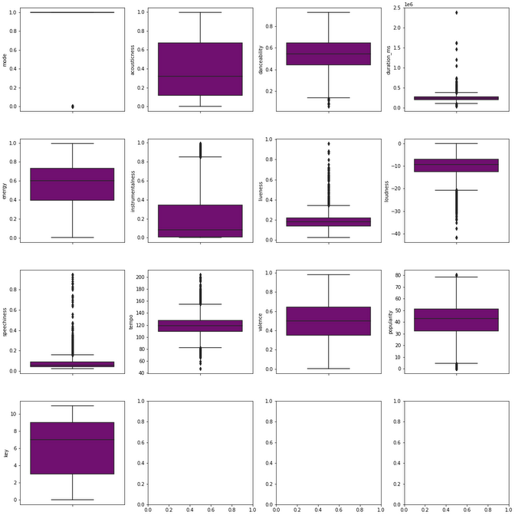
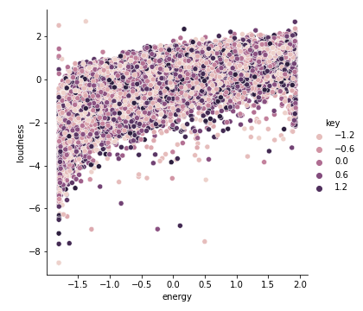
Let’s understand the data.
Numeric Values of data.csv
Loudness V/s Energy

Slide 6
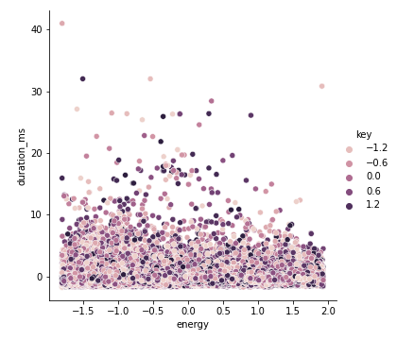
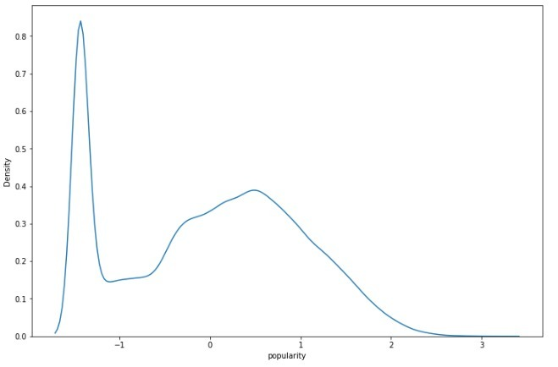
Energy v/s Duration_ms
Popularity KDE plot

Slide 7
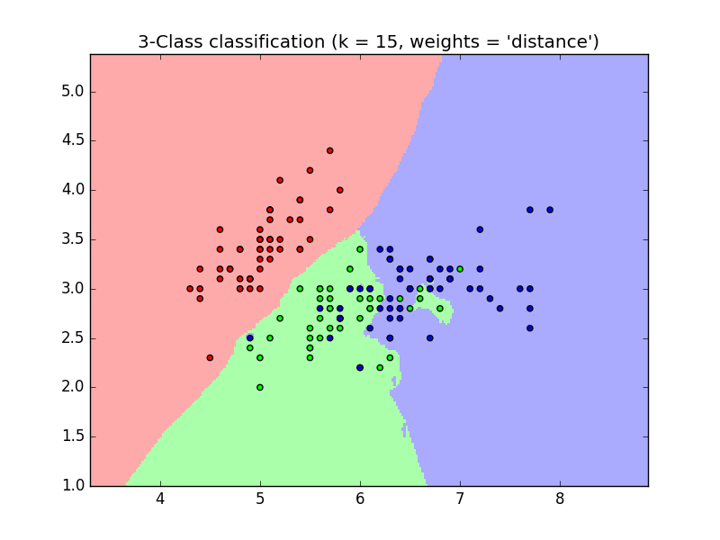
Nearest Neighbor
The principle behind nearest neighbor methods is to find a predefined number of training samples closest in distance to the new point, and predict the label from these.
It is widely disposable in real-life scenarios since it is non-parametric, meaning, it does not make any underlying assumptions about the distribution of data.

Slide 8
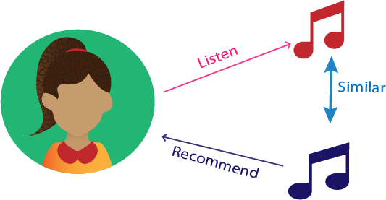
Content Based Recommendation
A Content-Based Recommender is based on the data we get from users, either explicitly (ratings) or implicitly (clicking on a link).
We develop a user profile based on the data, which is then used to provide recommendations to the user. As the user offers additional information or acts on the advice, the engine becomes more accurate.

Slide 9
Now let us look at the implementation!

Slide 10
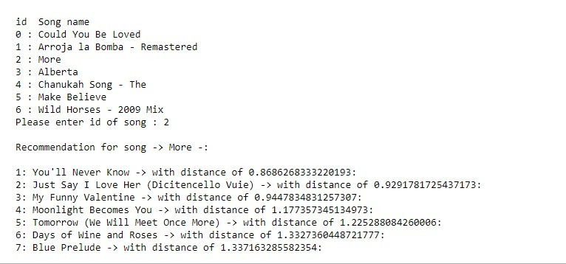
Results
The recommendation system provides users ten tracks with their IDs. Based on the user's selection of ID, it recommends seven tracks that are similar to the track of user's choice.

Slide 11
Conclusion
The attributes of a song used in this recommender system are tempo, energy, liveliness, loudness, danceability, and many other important characteristics are utilized. The recommender system takes into account all the relevant features of a song that practically describes all the qualities of a song.

Slide 12
Thank You

